Slide 1
Secure data hiding in image using steganography
CAPSTONE PROJECT
Presented By: Ayushman Mishra
Student Name : Ayushman Mishra
College Name & Department : Siksha ‘O’ Anusandhan (ITER) BBSR

Slide 2
OUTLINE
Problem Statement
Technology used
Wow factor
End users
Result
Conclusion
Git-hub Link
Future scope

Slide 3
Problem Statement
With the rise in digital communication, securing sensitive data is crucial. Traditional encryption methods can attract attention, making them vulnerable. Image steganography offers a covert way to hide data within images, but existing methods often compromise image quality and are prone to detection. This project aims to develop a secure and efficient steganography technique that ensures high embedding capacity, preserves image integrity, and resists steganalysis attacks for safe data transmission.

Slide 4
Technology used
• Programming Language: Python
• Image Processing: OpenCV, Pillow
• Data Handling: NumPy
• Additional Libraries: Cryptography modules and/or dedicated steganography libraries
• Platforms: Compatible with most OS, ensuring ease of deployment

Slide 5
Wow factors
• Innovative Algorithm: High embedding capacity with minimal image distortion
• Robust Security: Resistant to common steganalysis attacks
• User-Friendly: Easy integration and deployment for secure communication
• Cutting-Edge: Leverages modern image processing and cryptographic techniques

Slide 6
End users
• Security Professionals: For covert data transmission and digital forensics
• Organizations: Seeking secure methods to share sensitive information
• General Users: Individuals who require privacy in digital communication

Slide 7

Results

Slide 8
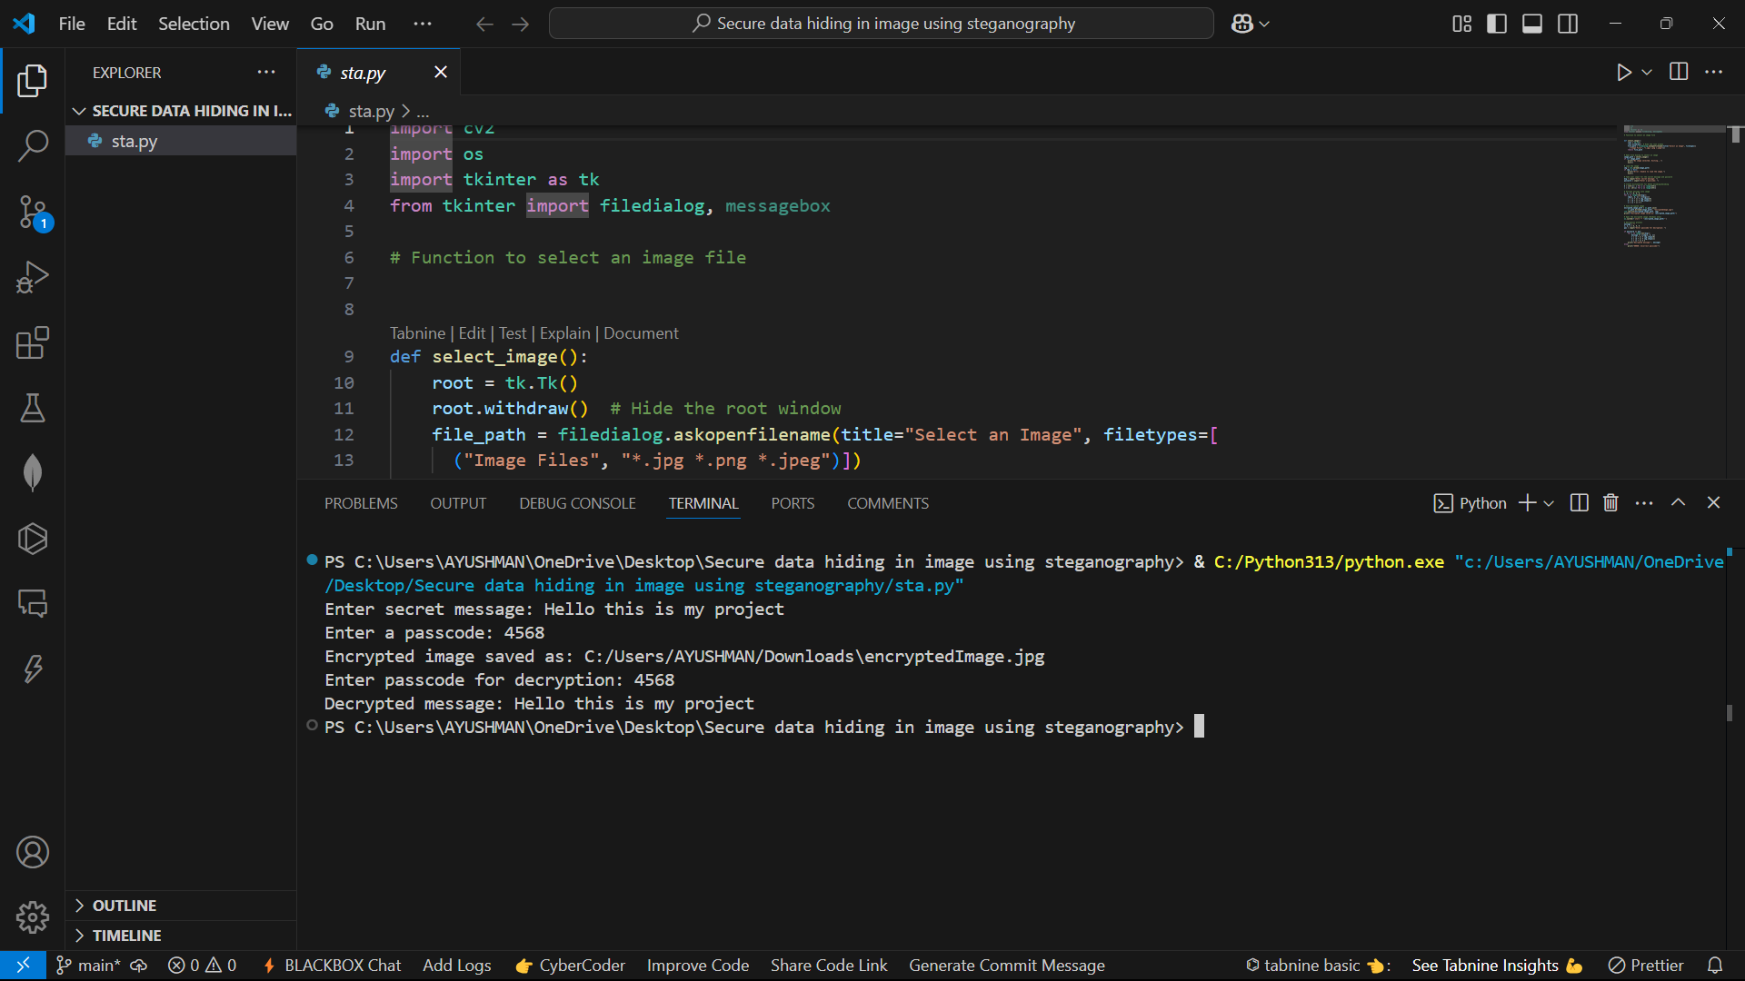
Results

Slide 9
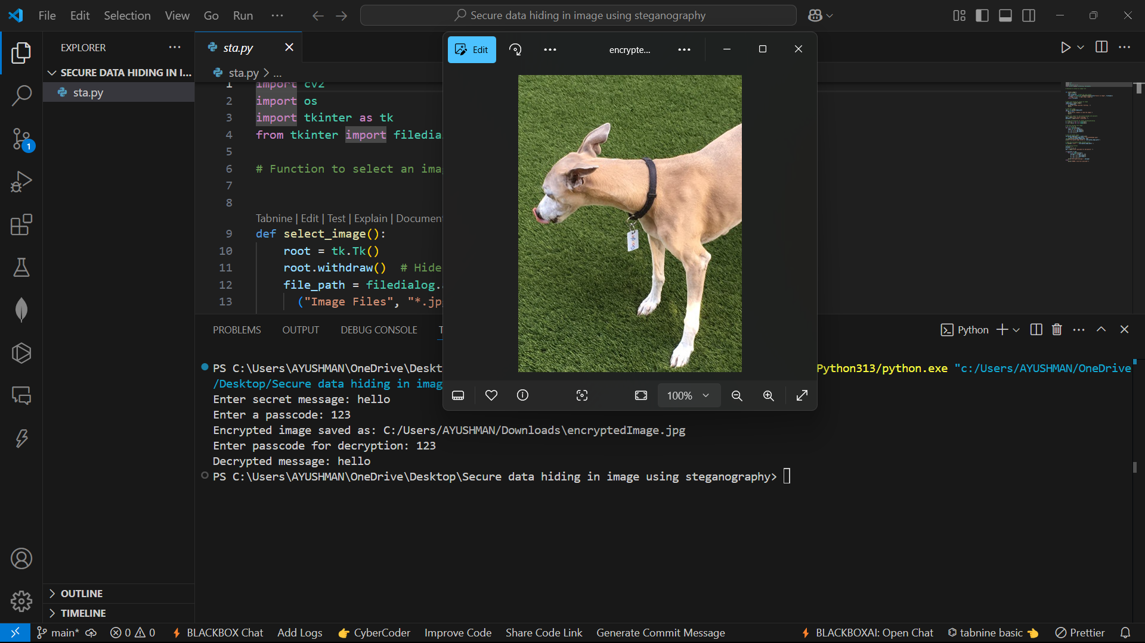
Results

Slide 10
Conclusion
This project successfully implements a secure image steganography technique for covert data transmission. By embedding data within images while maintaining visual integrity, the method ensures confidentiality without raising suspicion. The use of advanced image processing and cryptographic techniques enhances security, making it resistant to detection through steganalysis. The results demonstrate a high data hiding capacity with minimal distortion, proving the effectiveness of the approach. This solution can be beneficial for secure communication in various domains, including cybersecurity, confidential messaging, and digital forensics. Future improvements can further enhance efficiency and robustness for real-world applications.

Slide 11
GitHub Link
https://github.com/ayushman8658/Secure-data-hiding-in-image-using-steganography-

Slide 12
Future scope(optional)
• Algorithm Enhancement: Explore dynamic data embedding for various media types • Advanced Security: Incorporate machine learning for adaptive steganalysis resistance • Optimization: Further optimize for higher payload capacities and faster processing times • Integration: Expand applicability to real-time communication platforms

Slide 13
THANK YOU

